Slide 1
Motivation Concepts

Slide 2
Motivation
One of the most important topics in OB
How can we, as managers, make people work hard?

Slide 3
Input
Processes
Output

Slide 4

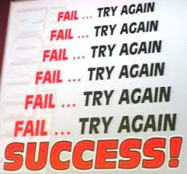

Definition of Motivation in OB
Motivation is “the processes that account for an individual’s intensity, direction, and persistence of effort toward attaining an organizational goal.”

Slide 5
Early Theories of Motivation
Hierarchy of Needs Theory
Theory X and Theory Y
Two-Factor Theory
McClelland’s Theory of Needs

Slide 6
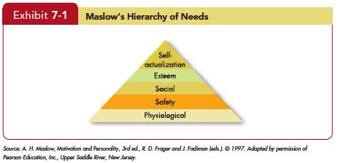
Hierarchy of Needs Theory
Achieving potential
Autonomy, recognition
Higher Order
Affection, friendship
Security from harm
Lower Order
Bodily needs

Slide 7
Hierarchy of Needs Theory
Managerial Implications?

Slide 8
Hierarchy of Needs Theory
Wide recognition from practitioners
Not completed validated

Slide 9
Theory X and Theory Y
Theory X: negative assumption
Employees dislike and avoid work
Manage style
Theory Y: positive assumption
Employees can enjoy work
Manage style

Slide 10
Hierarchy of Needs & Theory X and Theory Y
Theory Y
Theory X

Slide 11
Theory X and Theory Y
McGregor believed that
(Theory X/ Theory Y) assumptions were more valid than (Theory X/Theory Y).
Managerial Implications?

Slide 12
Two-Factor Theory (Motivation-Hygiene Theory) (by Hertzberg)
Motivation Factors vs. Hygiene Factors
Motivation
Intrinsic
work itself or the outcomes from it
Related job satisfaction
Personal growth opportunities, recognition, promotional opportunities, responsibilities, etc.
Hygiene
Extrinsic
Related job dissatisfaction
Company policies, working conditions, pay, supervision, etc.

Slide 13
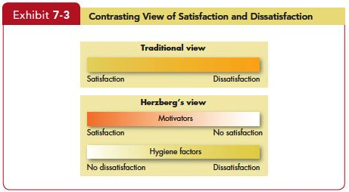
Two-Factor Theory (Motivation-Hygiene Theory)

Slide 14
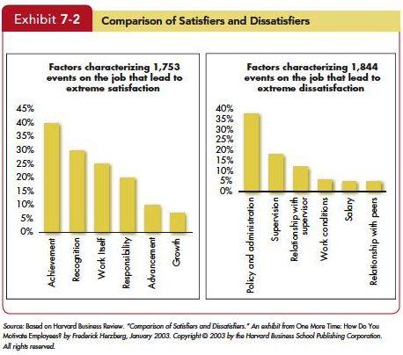
Two-Factor Theory (Motivation-Hygiene Theory)
Intrinsic
Extrinsic

Slide 15
Two-Factor Theory (Motivation-Hygiene Theory)
Managerial Implications

Slide 16
Theory of Needs (by McClelland)
Individual Difference
Need for Achievement
The drive to excel in relation to a set of standards
Need for Power
Need to make others behave in a way they would not have otherwise
Need for Affiliation
Desire for close interpersonal relationships

Slide 17
Theory of Needs (by McClelland)
When work has a high responsibility and moderate level of risk
Need for Achievement
Need for Power
Need for Affiliation
Success

Slide 18
Theory of Needs (by McClelland)
Which needs have a strong relationship to managerial success?
Need for Achievement
Need for Power
Need for Affiliation
Managerial Success?

Slide 19
Theory of Needs (by McClelland)
Managerial Implications

Slide 20
Contemporary Motivation Theories
Self-determination theory
Cognitive Evaluation theory
Self-concordance theory
Goal-setting theory
Self-efficacy theory (social-learning theory)
Reinforcement theory
Equity theory
Expectancy theory

Slide 21
Self-Determination Theory
People prefer to feel they have control over their actions.
Managerial Implication?
Autonomy
Motivation

Slide 22
Cognitive Evaluation Theory
Sub theory of self-determination theory
Extrinsic rewards reduce intrinsic motivation
Want to do → have to do
Some exceptions

Slide 23
Cognitive Evaluation Theory
Managerial Implications

Slide 24
Self-Concordance Theory
Self-concordance:
Another sub-theory
Managerial implications
Fit between
interest(core values) and job
Motivation

Slide 25
Goal-Setting Theory
Specific goal
Higher Performance
Challenging goal
Feedback

Slide 26
Goal-Setting Theory
Why challenging goals?

Slide 27
Goal-Setting Theory
Situation
Specific goal
Higher Performance
Challenging goal
Feedback

Slide 28
Goal-Setting Theory
Other important factors
Goal commitment

Slide 29
Goal-Setting Theory
Other important factors
Goal commitment
Want to achieve
Believe the achievability
Public commitment
Internal locus of control (belief about controllability)

Slide 30
Goal-Setting Theory
Other important factors
Goal commitment
Want to achieve
Believe the achievability
Public commitment
Internal locus of control (belief about controllability)
Task characteristics

Slide 31
Goal-Setting Theory
Other important factors
Goal commitment
Want to achieve
Believe the achievability
Public commitment
Internal locus of control (belief about controllability)
Task characteristics
Simple vs. complex
Independent vs. interdependent

Slide 32
Goal-Setting Theory
Managerial Implications

Slide 33
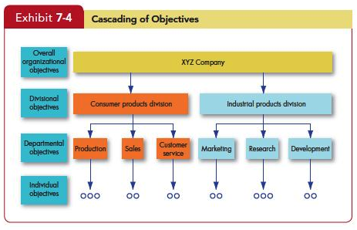
Goal-Setting Theory

Slide 34
Self-Efficacy Theory
Self-efficacy: an individual’s belief that he or she is capable of performing a task
Positive Spiral
High self-efficacy
more engagement
increase performance
higher self-efficacy

Slide 35
Self-Efficacy Theory
4 ways to increase self-efficacy
Enactive mastery: experience
Vicarious modeling: watching similar others
Verbal persuasion: convincing and supporting
Arousal: psyched up
Managerial Implications?

Slide 36
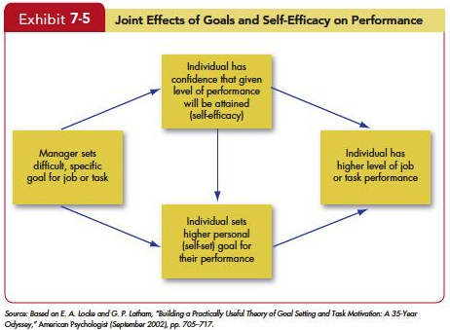
Goal setting + self-efficacy

Slide 37
Goal setting + self-efficacy
Managerial Implications? (continue)

Slide 38
Reinforcement Theory
Reinforcement:
Consequence (reward or punishment) → behavior
Consequence
Behavior

Slide 39
Changing behavior through consequences
How can we control tardiness?

Slide 40
Reinforcement Theory
Added
Removed
Pleasant event
Positive reinforcement
Extinction
Unpleasant
event
Punishment
Negative reinforcement
Increase target behavior
Decrease target behavior

Slide 41
Quiz
You finish your task on time and your boss praises your performance.
When you make a mistake in scheduling an important meeting, your boss yells at you in front of people.
You stop laughing at your colleague’s silly jokes and he stops.
A professor has a policy of exempting students from the final exam if they maintain perfect attendance during the quarter.

Slide 42
Reinforcement Theory
Goal-Setting vs. Reinforcement Theory
Cognitive approach vs. behavioristic view

Slide 43
Reinforcement Theory
Management implications?

Slide 44
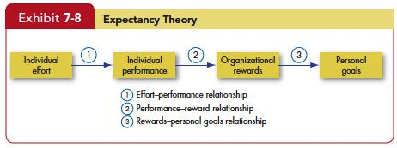
Expectancy Theory
expectancy
instrumentality
valence

Slide 45
Expectancy Theory
Expectancy Theory
Motivation is a product of the individual's expectancy that a certain effort will lead to the intended performance, the instrumentality of this performance to achieving a certain result, and the desirability of this result for the individual, known as valence

Slide 46
Expectancy Theory
An employee will be motivated when they believe
Effort will lead to a good performance.
A good performance will lead to rewards.
The rewards will satisfy his/her personal goals.

Slide 47
Expectancy Theory
Managerial implications?

Slide 48
Fairness Perception
Fairness perception
Motivation

Slide 49
Equity Theory
A theory that says that individuals compare their job inputs and outcomes with those of others and then respond to eliminate any inequities.

Slide 50
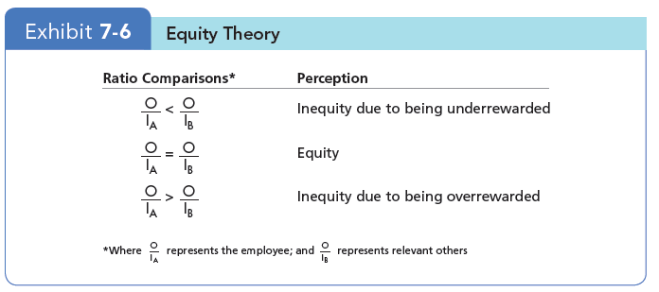
Equity Theory
Comparing output/input ratio with that of others

Slide 51
Equity Theory
Equity (fair)
Inequity (unfair)
Under-reward
Change input or output
Choose a different referent
Leave the field
Over-reward
Distort perceptions of self or others

Slide 52
Equity Theory
Limitation

Slide 53
Organizational justice
An overall perception of what is fair in the workplace
Distributive
Procedural
Interactional

Slide 54
Organizational justice
Managerial implications?

